Slide 1
Graph Optimization in Neural Models OD101KLU
Id : 180030075
Name : V.Mounica
Sec : 3

Slide 2
Abstract
Machine learning in today’s era is influencing various different features on various different products. So far this paradigm has been restricted to the cloud and with increasing capability on mobile devices things are moving towards on device ML so optimization became the need of hour for on Device Execution
The existing optimization device specific can be analyzed and optimized so it can be applied to different model types.

Slide 3
Literature survey
https://towardsdatascience.com/deepwalk-its-behavior-and-how-to-implement-it-b5aac0290a15
https://gordicaleksa.medium.com/how-to-get-started-with-graph-machine-learning-afa53f6f963a
https://towardsdatascience.com/onnx-easily-exchange-deep-learning-models-f3c42100fd77
https://thenewstack.io/tutorial-using-a-pre-trained-onnx-model-for-inferencing/

Slide 4
Introduction
Optimization become the need of hour for on device execution
The growth of different model frameworks leads to cross device and cross framework usage of same model. Onnx helps in achieving the same.
However, optimizations so far has been device specific which can be generalized to onnx framework.

Slide 5
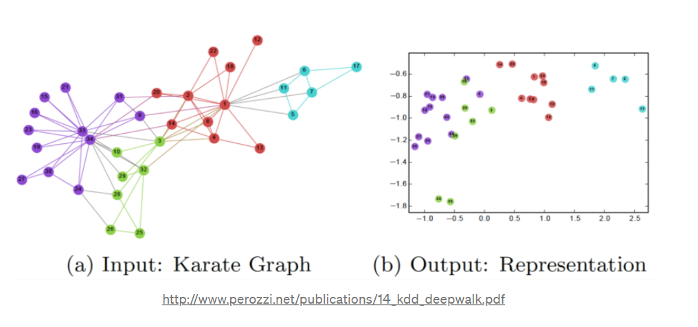
Existing work
We have various existing ml models which can be executed on different platforms where each have their own algorithm
Algorithms :
Deep Walk is an algorithm that is used to create embeddings of the nodes in a graph.

Slide 6
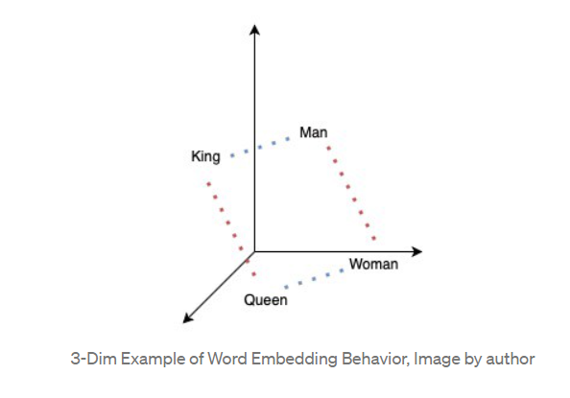
Word2Vec allowed for words to be embedded into n-dimensional space, with similar words being locally situated near each-other.

Slide 7
GraphSAGE is capable of predicting embedding of a new node, without requiring a re-training procedure.
GraphSAGE is an inductive representation learning algorithm that is especially useful for graphs that grow over time. It is much faster to create embeddings for new nodes with GraphSAGE compared to transductive techniques. Additionally, GraphSAGE does not compromise performance for speed.

Slide 8
Proposed work
Experiment on existing device specific graph optimization techniques
Evaluate of ONNX inference
Identification and proposal for optimization issues.

Slide 9


